Slide 1
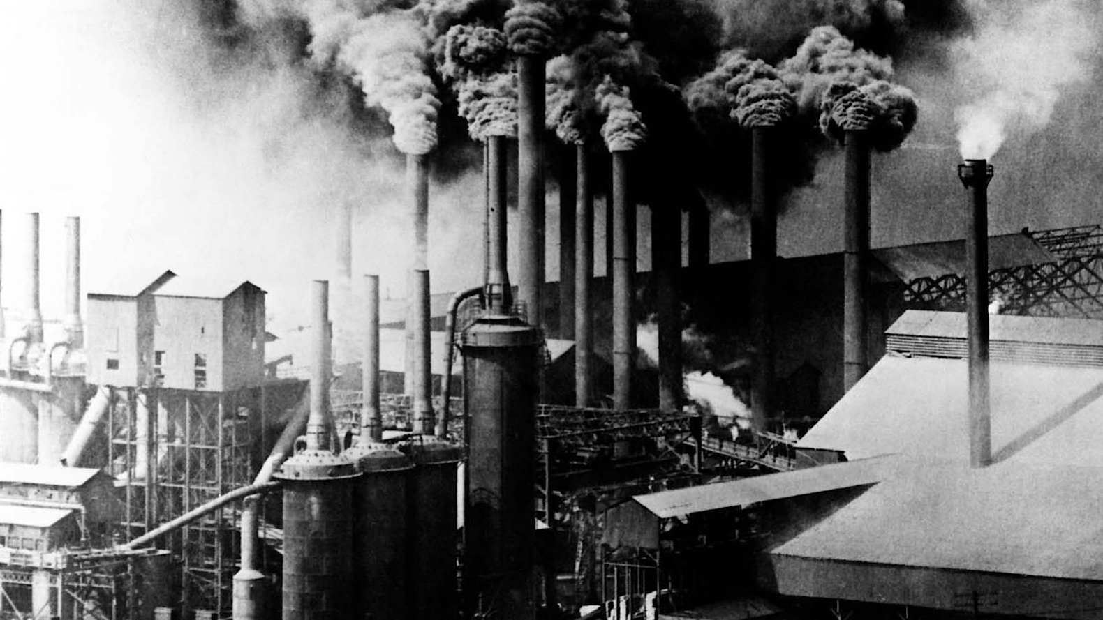
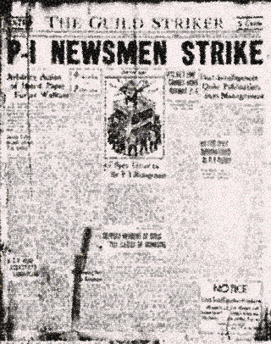
Change and development in industrial society
Chapter 5
Done by :Maryam, Julianne, Aayisha, Balkis and Kaysar

Slide 2
Starter Activity
CAN YOU THINK OF SOME REASONS THAT MAY LEAD INDUSTRIAL WORKERS TO GO ON STRIKE
DO YOU KNOW OF ANY STRIKES OR UNIONS ​
THAT HAPPENED IN YOUR COMMUNITY OR ​
ANYTHING THAT YOU HAVE SEEN IN THE NEWS.

Slide 3
Starter Activity
CAN YOU THINK OF SOME REASONS THAT MAY LEAD INDUSTRIAL WORKERS TO GO ON STRIKE
DO YOU KNOW OF ANY STRIKES OR UNIONS ​
THAT HAPPENED IN YOUR COMMUNITY OR ​
ANYTHING THAT YOU HAVE SEEN IN THE NEWS.

Slide 4
Lob: to understand what are strikes and unions

Slide 5

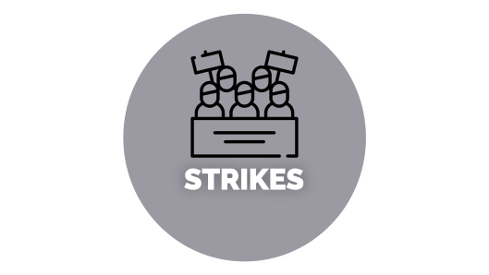
STRIKES AND UNIONS
5.7 PAGE 87

Slide 6

STRIKES

Slide 7
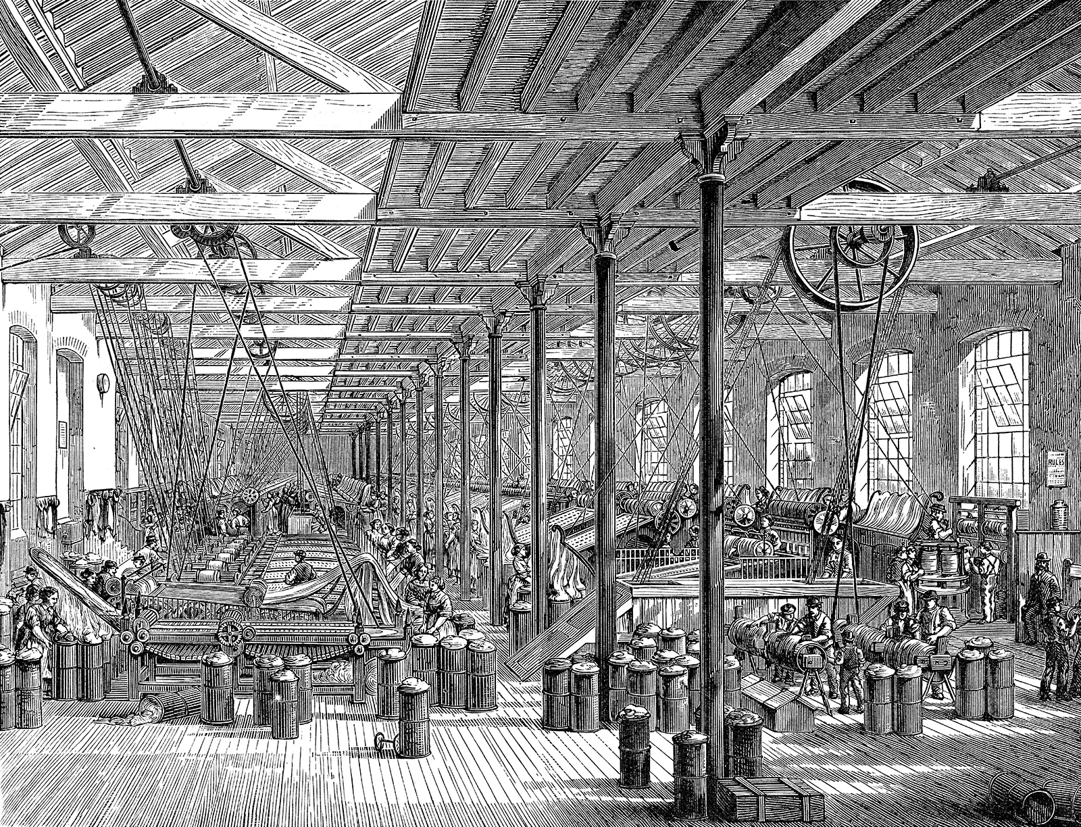
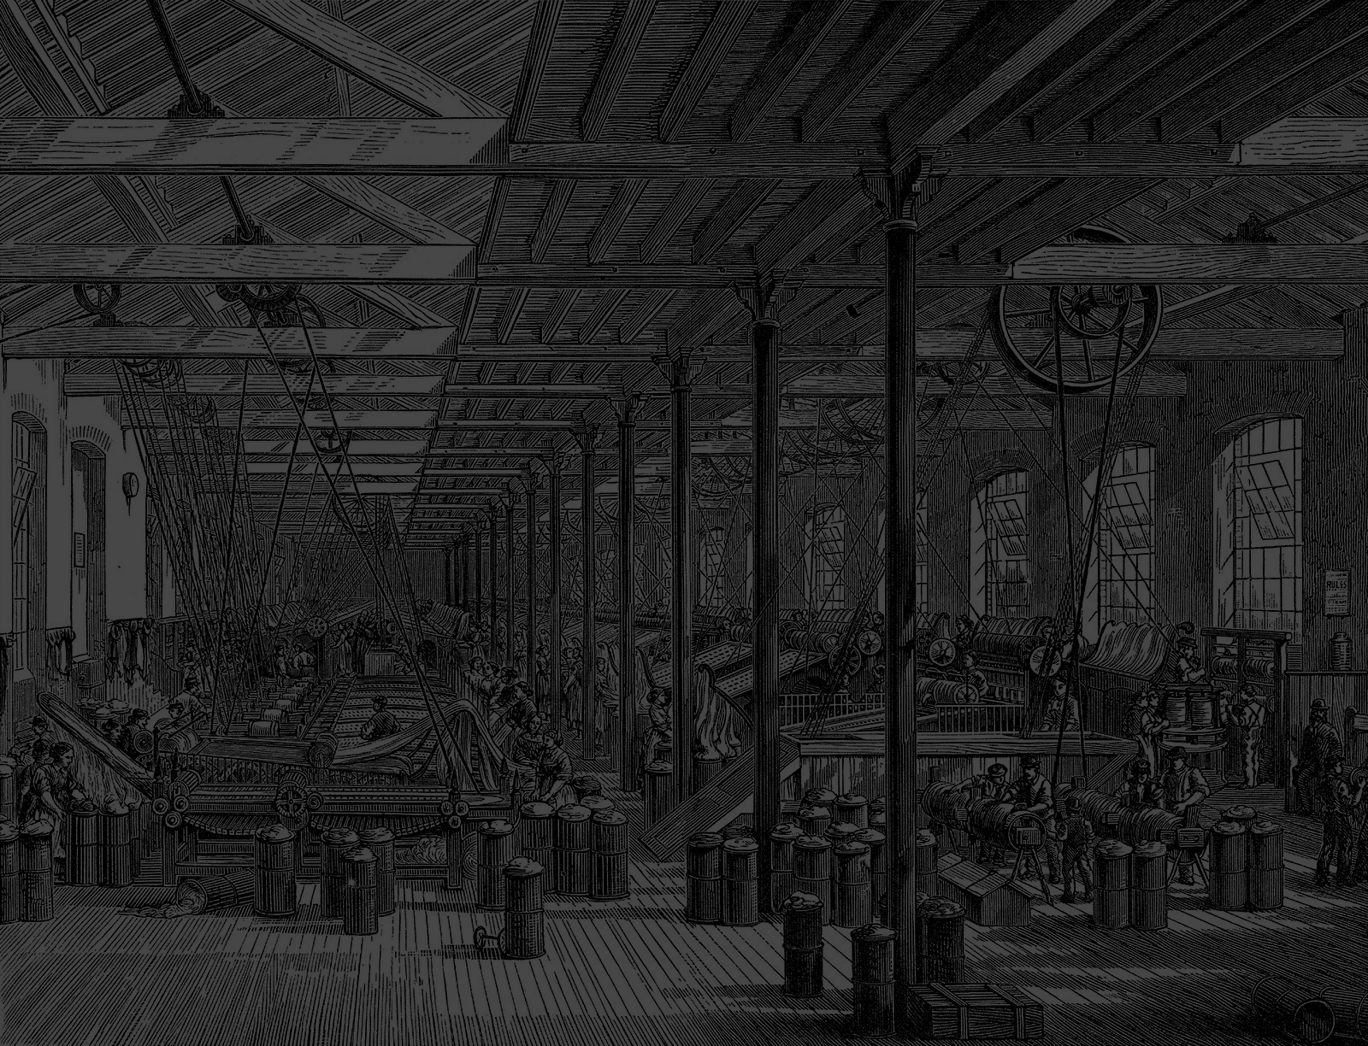
STRIKES
A Strike is a collective action taken by a group of workers in which they refuse to work as a form of protest. This action is often triggered by unfair/low wages, harsh working conditions, or other labor-related issues.
Strikes can be economic, intended to improve wages and benefits, or can be in response to labor practices.
In a strike, workers do not go to work while in a lockout, the management shuts the gate and prevents workers from coming.
To call it a strike, it is a difficult decision as managers may attempt to use substitute labor, and workers would also face difficulties sustaining themselves without wages.

Slide 8

UNIONS

Slide 9
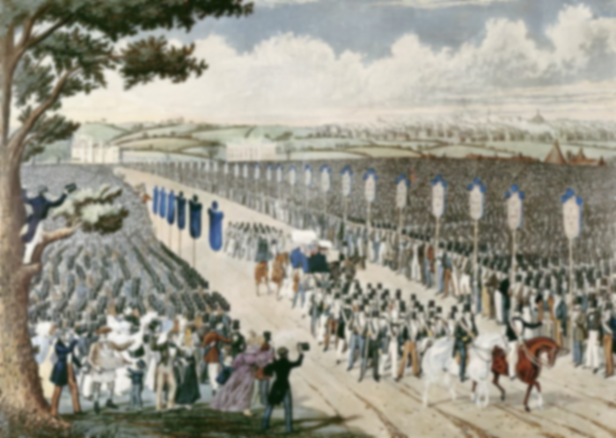
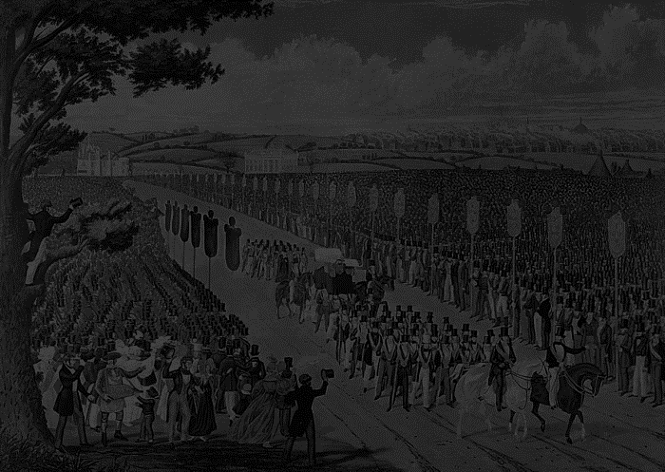
UNIONS
Trade unions, also known as labor unions, are organized associations of workers formed to protect and promote their common interests through collective action, the social, economic, and political interests of its members.
These organizations work on behalf of their members to negotiate with employees, advocate for better wages and working conditions, and ensure that worker’s rights are upheld. They can be found in various industries, such as education, healthcare, and manufacturing.
.

Slide 10
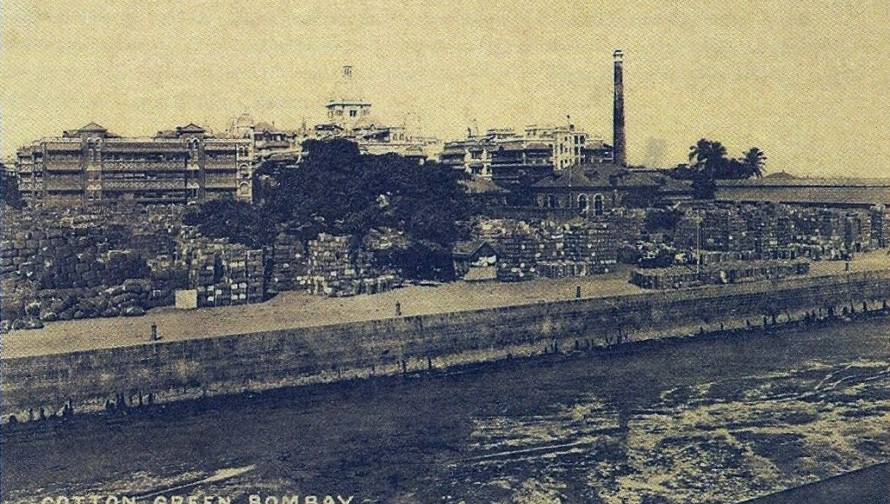
Bombay textile strike
IN1982…
BOMBAY
TEXTILE
STRIKE
The Bombay Textile strike, which was led by the trade union leader, Dr. Datta Samant lasted for almost two years.
It affected and involved around a quarter of a million workers, who were demanding for better wages and the right to form their own union.

Slide 11
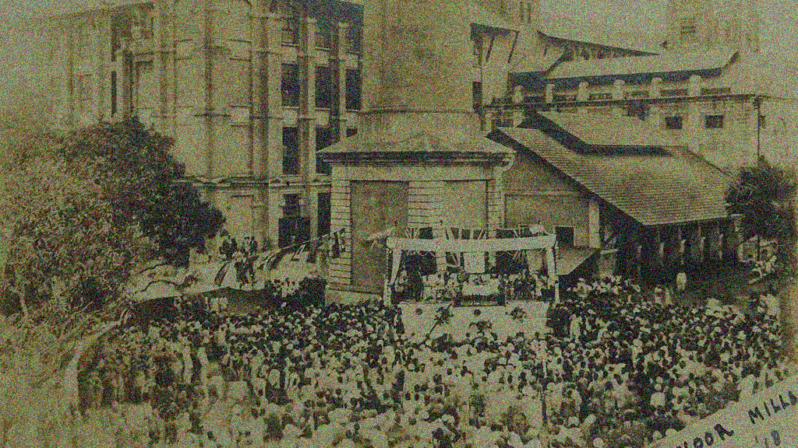

BOMBAY
TEXTILE
STRIKE
IN1982…
The Bombay Textile strike, which was led by the trade union leader, Dr. Datta Samant lasted for almost two years.
It affected and involved around a quarter of a million workers, who were demanding for better wages and the right to form their own union.
According to the Bombay Industrial Relations Act (BIRA), a union had to be ‘approved’ and the only way it could be ‘approved’ was if it gave up the idea of strikes.

Slide 12
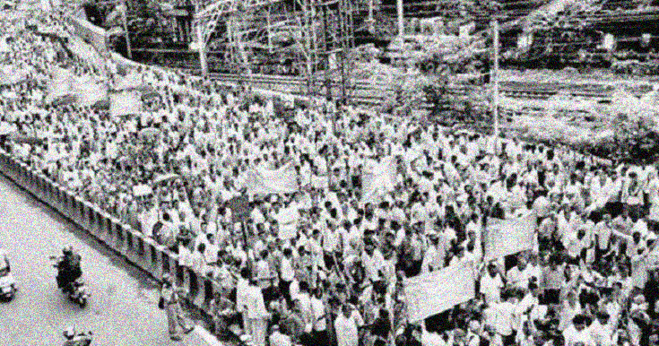
Congress-led Rashtriya Mill Mazdoor Sangh
(RMMS)
Was the only approved union and it helped to break the strike by bringing in other workers.
IN1982…
Despite their efforts, the Government didn’t respond to the worker’s demands. Slowly after two years, many workers were desperate for work and returned to their jobs but nearly one lakh of them lost their jobs and either went back to their villages or found casual labor. Some moved to smaller towns like Bhiwandi, Malegaon, and Ichalkaranji to work in the power loom sector.
The Bombay Textile strike, which was led by the trade union leader, Dr. Datta Samant lasted for almost two years.
It affected and involved around a quarter of a million workers, who were demanding for better wages and the right to form their own union.
According to the Bombay Industrial Relations Act (BIRA), a union had to be ‘approved’ and the only way it could be ‘approved’ was if it gave up the idea of strikes.

Slide 13
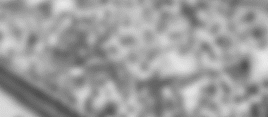
BOMBAY
TEXTILE
STRIKE
Congress-led Rashtriya Mill Mazdoor Sangh
(RMMS)
Was the only approved union and it helped to break the strike by bringing in other workers.
Despite their efforts, the Government didn’t respond to the worker’s demands. Slowly after two years, many workers were desperate for work and returned to their jobs but nearly one lakh of them lost their jobs and either went back to their villages or found casual labor. Some moved to smaller towns like Bhiwandi, Malegaon, and Ichalkaranji to work in the power loom sector.
According to the Bombay Industrial Relations Act (BIRA), a union had to be ‘approved’ and the only way it could be ‘approved’ was if it gave up the idea of strikes.

Slide 14
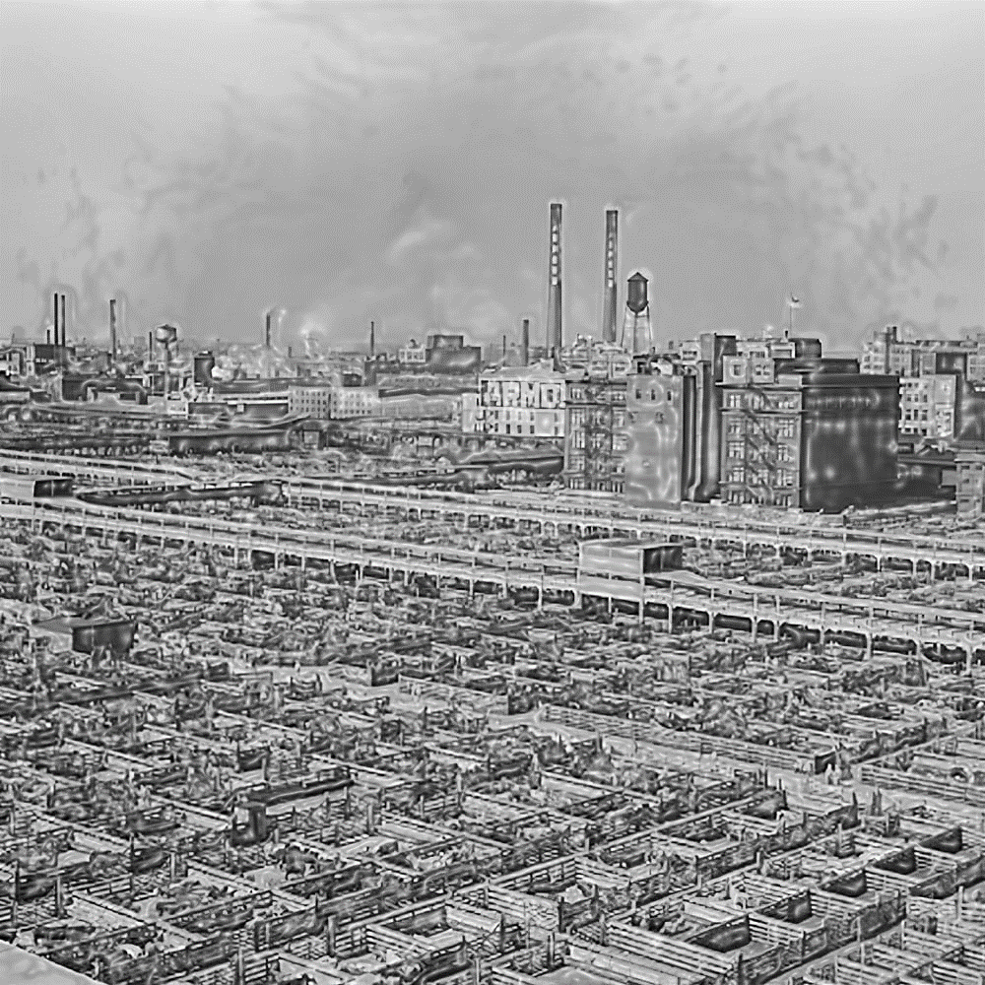
PAST
PRESENT
Mill Owners did not invest in Machinery
and Modernization.

Slide 15
PAST
PRESENT
Mill Owners are trying to sell off the mill land to real
estate dealers to build luxury apartments, leading to a
battle over who will define the future of Mumbai –
between workers and Mill Owners.

Slide 16
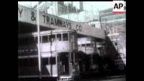
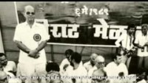
VIDEO

Slide 17




SOME UNIONS IN INDIA

Slide 18
SOME UNIONS IN INDIA
ALL INDIA TRADE UNION CONGRESS
(AITUC) Represents workers from various industries.

Slide 19

SOME UNIONS IN INDIA
INDIAN NATIONAL TRADE UNION CONGRESS
ALL INDIA TRADE UNION CONGRESS
(INTUC) is one of the largest trade unions in India..
(AITUC) Represents workers from various industries.

Slide 20

SOME UNIONS IN INDIA
BHARATIYA MAZDOOR
SANGH
INDIAN NATIONAL TRADE UNION CONGRESS
(BMS) is a Trade union associated with the Rashtriya Swayamsevak Sangh (RSS)
(INTUC) is one of the largest trade unions in India..

Slide 21


SOME UNIONS IN INDIA
HIND MAZDOOR SABHA
BHARATIYA MAZDOOR
SANGH
(HMS) is a Trade union organization with a presence in multiple states of India.
(BMS) is a Trade union associated with the Rashtriya Swayamsevak Sangh (RSS)

Slide 22
SOME UNIONS IN INDIA
ALL INDIA TRADE UNION CONGRESS
(AITUC) Represents workers from various industries.
ALL INDIA TRADE UNION CONGRESS
(AITUC) Represents workers from various industries.

Slide 23
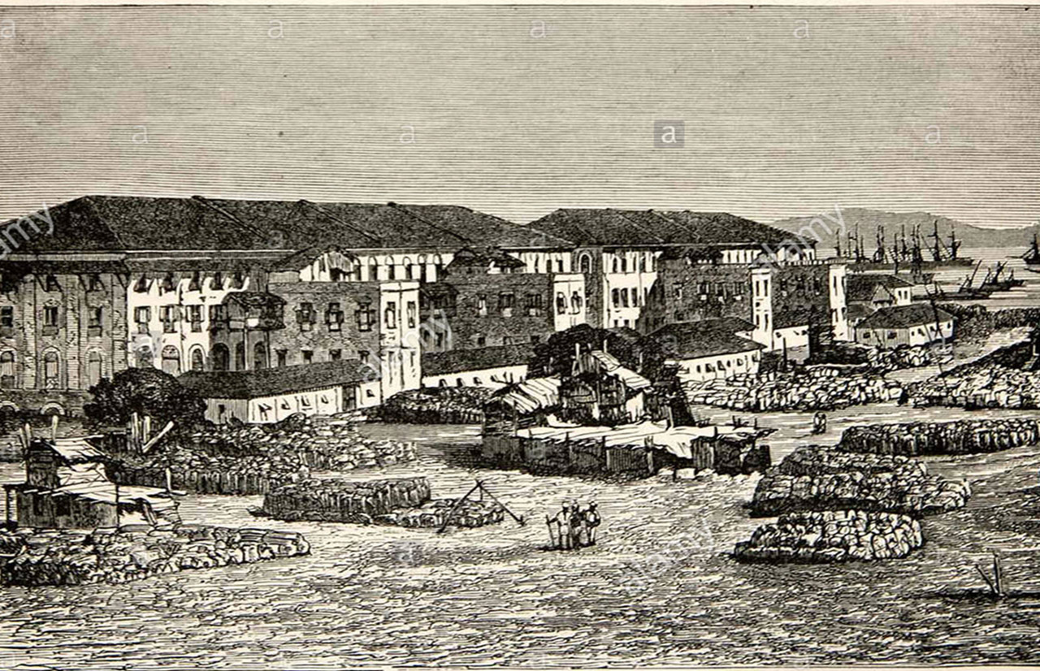
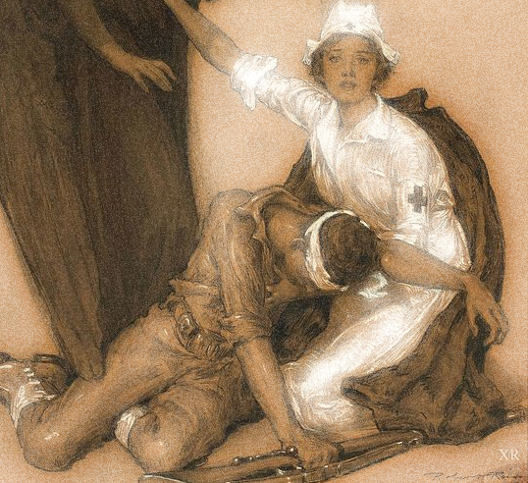
NURSE STRIKES IN U.S
Plenary
(click here)
Why and What Happens When Nurses Strike
Strike in Karnataka over
water-sharing disputes
Choose and write about any Two strikes that are mentioned here or research and come up with any 3 strikes that happened or are happening in 2023
OLA AND UBER DRIVERS STRIKE
IN TAMIL NADU
FACTORY STRIKES IN CHINA
US AUTO UNION STRIKE

Slide 24
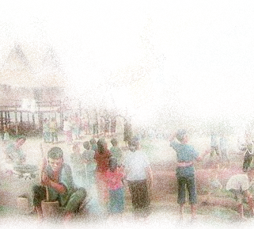
NURSE STRIKES IN U.S
Plenary
(click here)
Why and What Happens When Nurses Strike
Choose and write about any Two strikes that are mentioned here or research and come up with any 3 strikes that happened or are happening in 2023
Strike in Karnataka over
water-sharing disputes
OLA AND UBER DRIVERS STRIKE
IN TAMIL NADU
FACTORY STRIKES IN CHINA
US AUTO UNION STRIKE

Slide 25
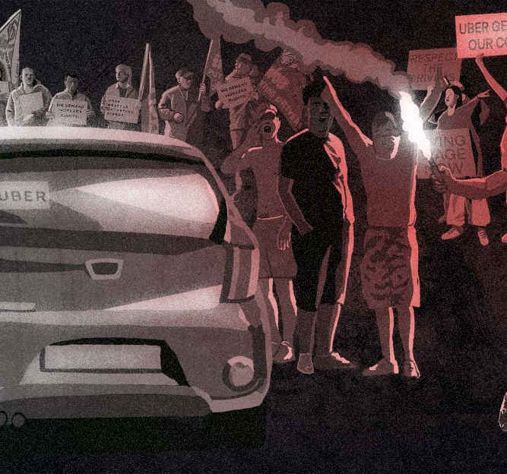
NURSE STRIKES IN U.S
Strike in Karnataka over
water-sharing disputes
Plenary
(click here)
Why and What Happens When Nurses Strike
(click here)
The Governments Response And The Causes Of The Strike
Choose and write about any Two strikes that are mentioned here or research and come up with any 3 strikes that happened or are happening in 2023
OLA AND UBER DRIVERS STRIKE
IN TAMIL NADU
FACTORY STRIKES IN CHINA
US AUTO UNION STRIKE

Slide 26
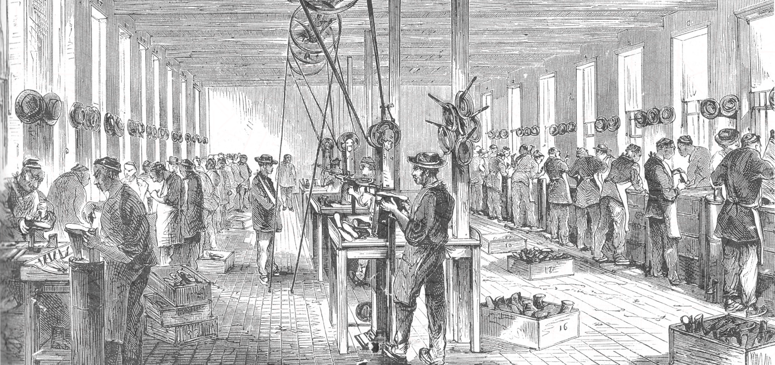
NURSE STRIKES IN U.S
Strike in Karnataka over
water-sharing disputes
Plenary
(click here)
The Governments Response And The Causes Of The Strike
OLA AND UBER DRIVERS STRIKE
IN TAMIL NADU
Choose and write about any Two strikes that are mentioned here or research and come up with any 3 strikes that happened or are happening in 2023
(click here)
Ola and Uber Drivers Struggles
FACTORY STRIKES IN CHINA
US AUTO UNION STRIKE

Slide 27
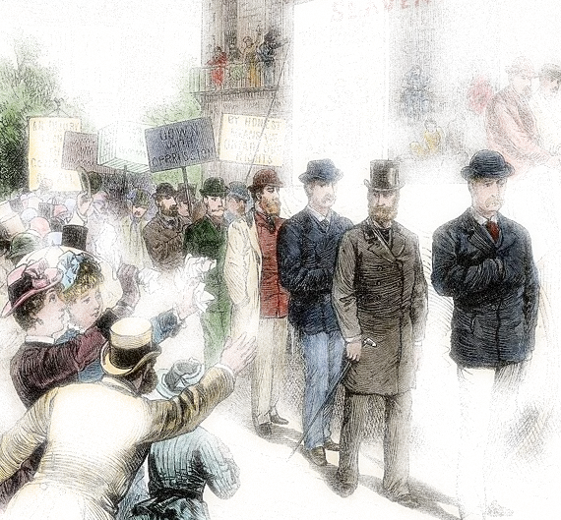
NURSE STRIKES IN U.S
Plenary
Strike in Karnataka over
water-sharing disputes
OLA AND UBER DRIVERS STRIKE
IN TAMIL NADU
Choose and write about any Two strikes that are mentioned here or research and come up with any 3 strikes that happened or are happening in 2023
(click here)
Ola and Uber Drivers Struggles
FACTORY STRIKES IN CHINA
(click here)
Workers Misery And Financial Difficulties Caused By Low Wages In Chinese Factories
US AUTO UNION STRIKE

Slide 28
NURSE STRIKES IN U.S
Plenary
Strike in Karnataka over
water-sharing disputes
OLA AND UBER DRIVERS STRIKE
IN TAMIL NADU
Choose and write about any Two strikes that are mentioned here or research and come up with any 3 strikes that happened or are happening in 2023
FACTORY STRIKES IN CHINA
(click here)
Workers Misery And Financial Difficulties Caused By Low Wages In Chinese Factories
US AUTO UNION STRIKE
(click here)
Labor Disputes Within The American Automotive Industry

Slide 29
T
H
A
N
K
Y
O
U

